Slide 1
Predicting Recessions
By avaneesh kolluri, jeremiah mcreynolds, matthew seedhom & thaenraj packiamani

Slide 2
Agenda
RESEARCH QUESTIONS
MOTIVATIONS
DESIGN AND EDA
DATA OVERVIEW
FEATURE ENGINEERING
MODEL SELECTION
RESULTS
CONCLUSION

Slide 3

Definitions
Economic Recession: "a period of temporary economic decline during which trade and industrial activity are reduced, generally identified by a fall in [Gross Domestic Product, or] GDP in two successive quarters." [1]
Macroeconomics: "the part of economics concerned with large-scale or general economic factors, such as interest rates and national productivity." [1]
  Ex: Gross Domestic Product (GDP), Inflation, National Income, Unemployment Levels
Microecnomics: "the part of economics concerned with single factors and the effects of individual decisions." [1]
  Ex: Household Income, Stock Market, Housing Markets, etc.
Gross Domestic Product: "the total value of goods produced and services provided in a country during one year." [1]
Notes:
Before we get started, let's define some of the terms you'll be hearing a lot through this presentation:

Slide 4

Research questions
Which factors contribute most to predicting a recession?
Can macroeconomic and/or microeconomic data solely predict that the United States is in a recession?
Can we generalize America's model against other, similar countries?

Slide 5

motivations
Economic recessions and their causes are well-studied
  Factors that lead to a recession are well-agreed upon by experts
Data is highly available for public consumption
Current economic uncertainties make this a valuable question
  COVID-19
  Current forecasting and classifications
Notes:
- Recessions have been studied for decades by economic experts. Their conclusions and findings are pretty well uniform
- Most of the data needed to predict or classify the economy as a recession is managed by the U.S. government, thus making is widely available for public consumption
> Ex: U.S. Bureau of Labor and Statistics
- COVID-19 has shaken the economy and led to much uncertainty

Slide 6
design
Well-studied macroeconomic factors for the United States economy
Leading sentiment microeconomic indicators
Sources are FRED and Yahoo Finance
Macroeconomic
Yield Curve (10 Year – 2 Year)
GDP
Inflation
Commercial and Industrial Loans
Microeconomic
NASDAQ Composite
Unemployment
S&P500
Manufactuering Unemployment
U.S. Median Income

Slide 7

Assumptions
Stock Market data is microecnomic
  Influences consumer choices
  Affects decisions of individual firms
Aggregated Household Income data is microeconomic
  Household income influences consumer choices
  Aggregation does not influence its classification
Notes:
- Stock Market data is often not classified as either "microeconomic" or "macroecnomic", generally it is simply put as an "investment". However, for the purposes of this project, we will assume it is microeconomic.
- Household income data aggregation should not affect a household's income influence on individual consumers. We simply use the average and yearly data to make the calculations easier, and it is usually the only way household income data is reported.

Slide 8

EDA
Reformat Data to Monthly
Resampling
Forward Fill
Percent Change
Replace Null Values
Imputation
Notes:
- Resample Stock Market Data and take Average per Month
- Take percent change to negate changes in currency, reporting values, etc.
- Replace null values by filling in data with an average of the data for that specific period
> E.g. if it is a recession, fill in data with an average of recession data, and vice versa

Slide 9
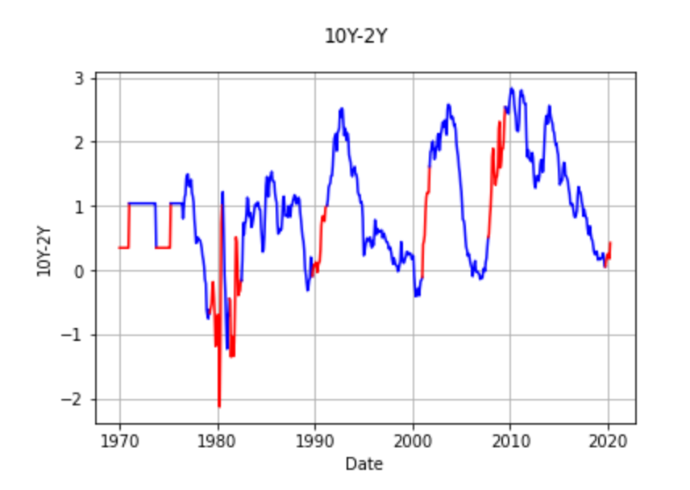
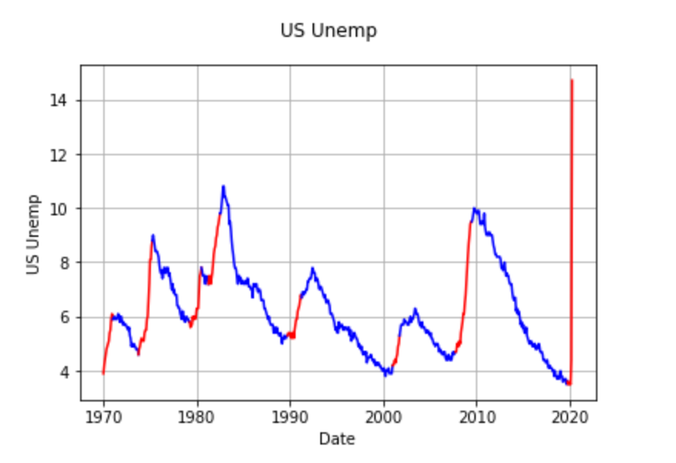
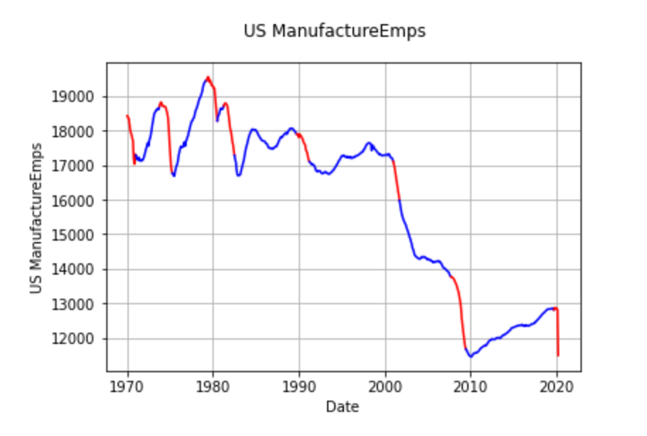
Data Discovery - Macroeconomic
Recessions in Red
Trends fairly evident
  Increases in Unemployment usually indicates recessions

Slide 10
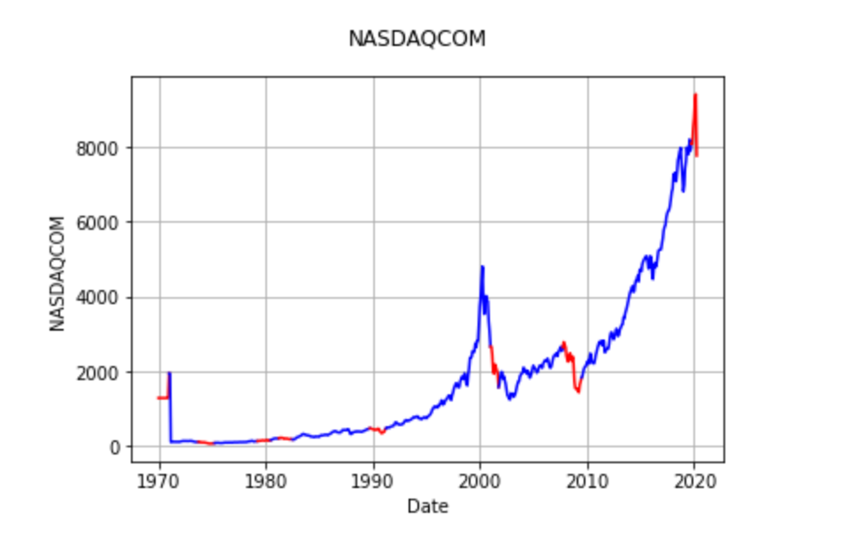
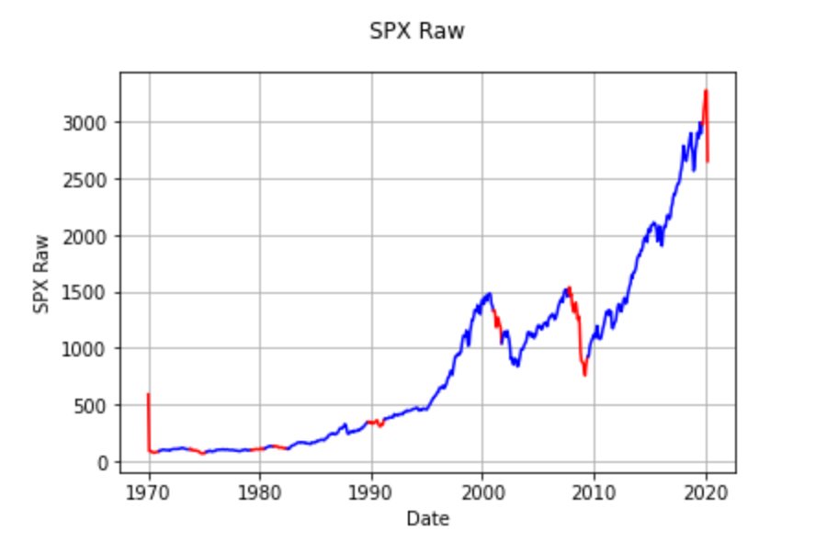
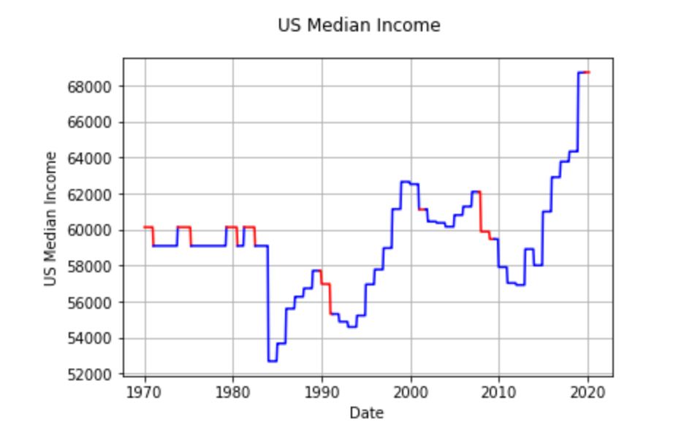
Data discovery - microeconomic
Recessions in Red
Some trends are evident
  Stock Market Falls align with recessions
  Median income drops align with recession

Slide 11
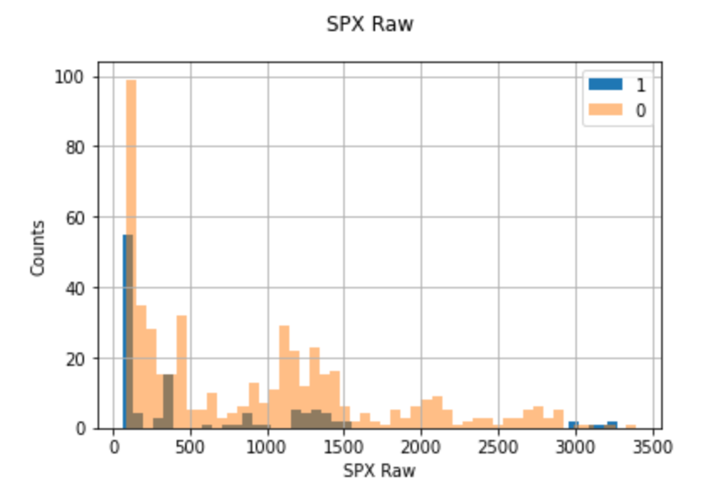
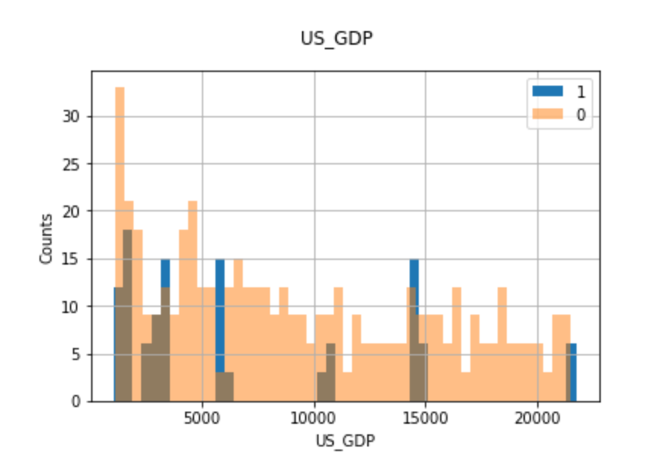
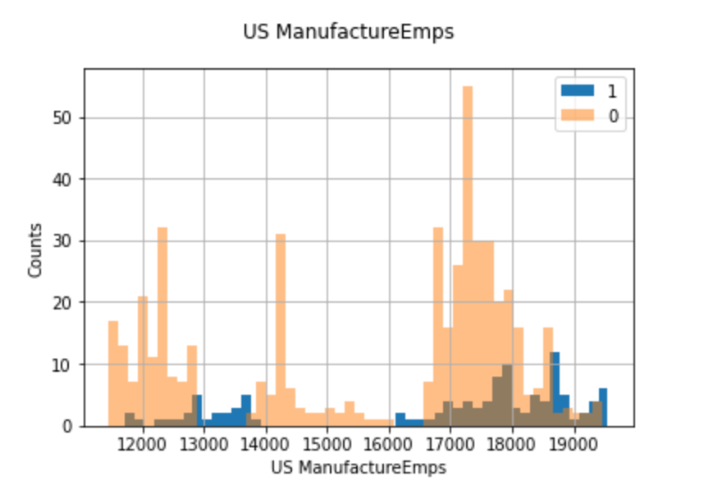
Data discovery - distribution
Non-Gaussian Distribution for Raw Data

Slide 12
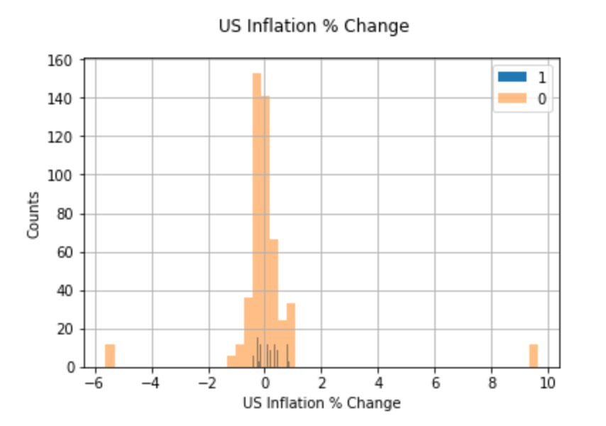
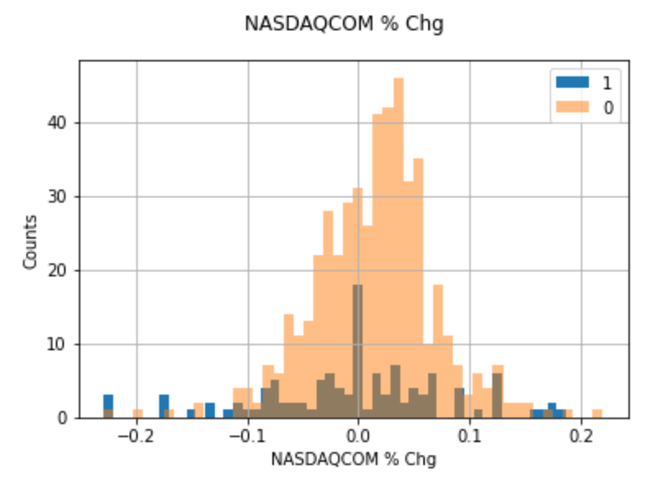
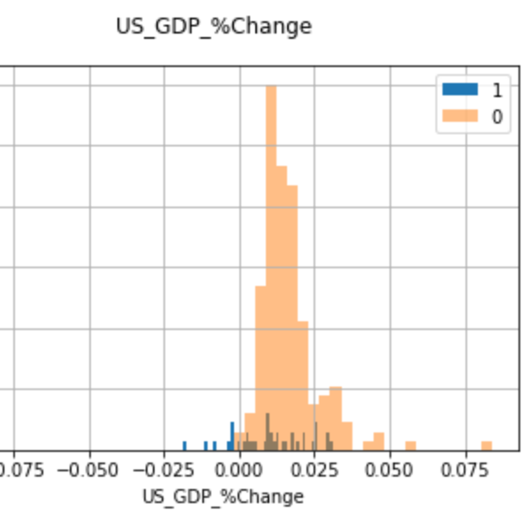
Data discovery - distribution
Mostly Gaussian Data with Percent Change Data
  Outliers prevalent
  Data less Gaussiant with recessions

Slide 13
Feature extraction
Data Separation
Microeconomic
Macroeconomic
Raw
Percent
Raw
Percent
All
Raw
Percent
Notes:
12 total data models once all of the parsing is done

Slide 14
Feature Selection
Microeconomic
Macroeconomic
Raw
Percent
Raw
Percent
All
Raw
Percent
Data Separation

Slide 15
Feature Selection
Principal Component Analysis
ANOVA
Correlation Matrices

Slide 16
Model selection
Select Model
Logistic Regression
Random Forest
Support Vector Machine
Tune Hyperparameters
Cross Validation
80 / 20 Split
Grid Search
Metric Measurements
ROC Curve
Bayes Search
Precision / Recall
Confusion Matrix

Slide 17
Results – U.S. data
Best Models
Random Forest
Raw Data
SVM
Percent Data
Random Forest
Microeconomic
SVM
Macroeconomic
Overall Successful
  Best models predict recessions ~86% correctly
  ANOVA and PCA tend to perform best

Slide 18
Results – canada data
Collect Data
Macroeconomic indicators
Use Best Models
Random Forest
SVM
Results
Raw data only
Generally not successful
~13% accuracy
Countries are different
Analysis

Slide 19
conclusions
Which factors contribute most to predicting a recession?
  Unemployment, Median Income, Stock Market Indexes and GDP Changes
    Both macro and microeconomic indicators
Can macroeconomic and/or microeconomic data solely predict that the United States is in a recession?
  Yes.
Can we generalize America's model against other, similar countries?
  Maybe, but not easily.

Slide 20
References
[1] Oxford Dictionary Definitions

